Slide 1
Lecture 01
Association and Simple Linear Regression

Slide 2
Reading assignment
Chapter: 1
Sections: 1.1 – 1.8
Main topics:
Association
Simple linear regression

Slide 3
Read the 📗!

Slide 5
A brief review ofPearson correlation

Slide 6
Objectives
Use a scatter plot to examine the linear relationship between two continuous variables.
Use correlation statistics to quantify the degree of association between two continuous variables.
Describe potential misuses of the correlation coefficient.
Use the CORR procedure to obtain Pearson correlation coefficients.

Slide 7
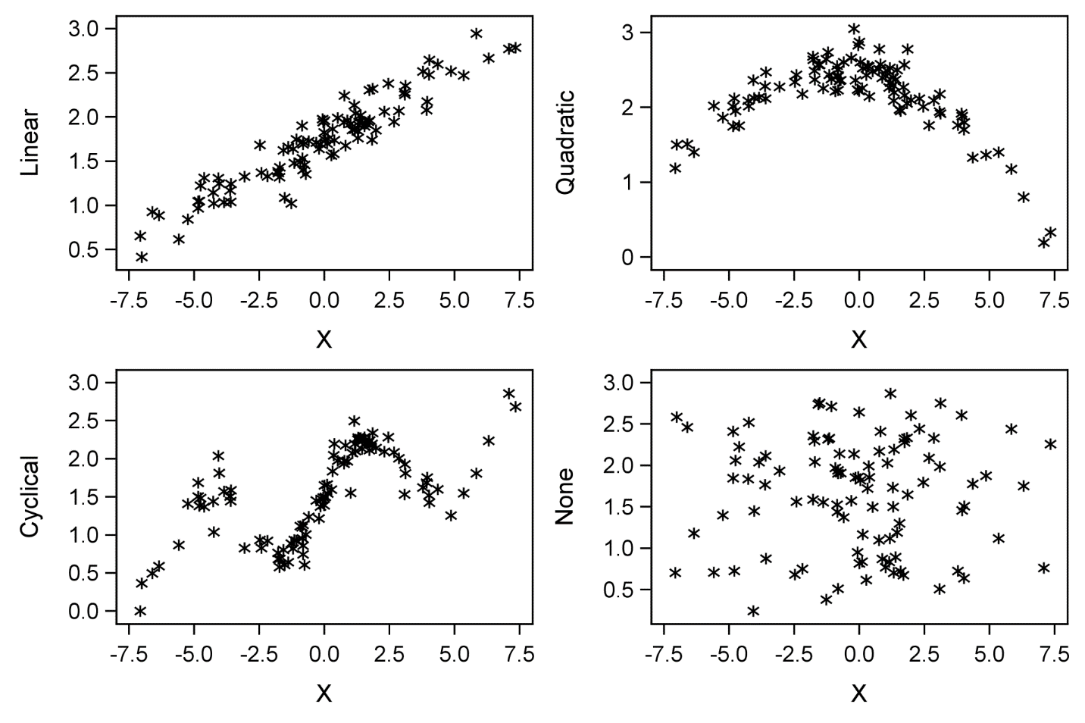
Pearson Correlation – Linear Relationships

Slide 8
Correlation

Slide 9
Hypothesis Test for a Correlation
The parameter representing correlation is ρ.
ρ is estimated by the sample statistic r.
H₀: ρ=0
Rejecting H0 indicates only great confidence that ρ is not exactly zero.
A p-value does not measure the magnitude of the association.
Sample size affects the p-value.

Slide 10
2.07 Multiple Answer Poll
Which of the following statements is/are true?
A Pearson correlation coefficient is a measure of linear association.
A nonsignificant p-value for a Pearson correlation means no relationship.
A negative Pearson correlation indicates a low degree of linear association.
A random cloud of data implies a negative correlation.
Notes:
Type answer here

Slide 11
2.07 Multiple Answer Poll – Correct Answer
Which of the following statements is/are true?
A Pearson correlation coefficient is a measure of linear association.
A nonsignificant p-value for a Pearson correlation means no relationship.
A negative Pearson correlation indicates a low degree of linear association.
A random cloud of data implies a negative correlation.
Notes:
Correct Answer: a

Slide 12
Cautions in Interpreting Correlations
Correlation between X and Y does not imply causation because:
It does not imply the direction of any possible causal relationship between X and Y
There might be a third variable that is the cause of changes in both variables, which means the association between X and Y is only indirect.
The Pearson Correlation only measures the linear association between X and Y.

Slide 13
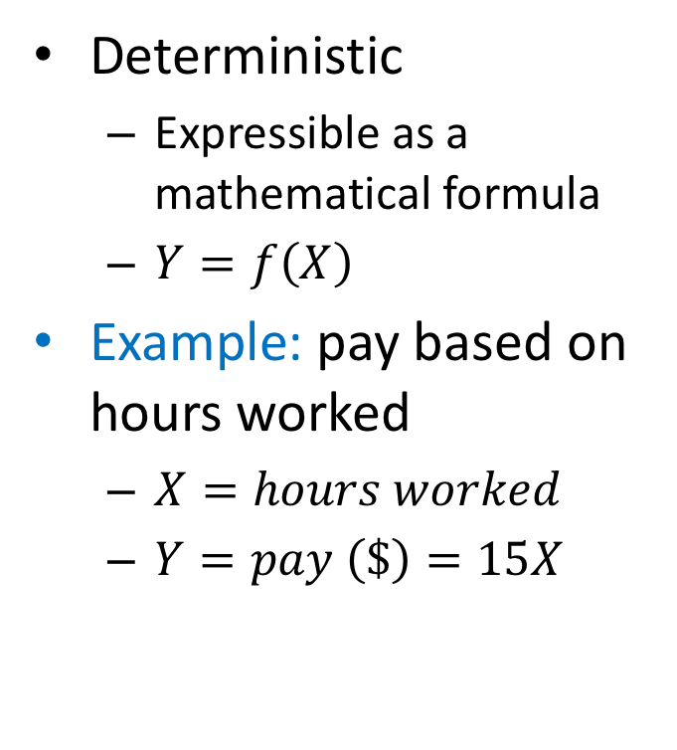
Functional relation
Deterministic
Expressible as a mathematical formula
$Y=f\left(X\right)$
Example: pay based on hours worked
$X=hours worked$
$Y=pay \left(\$\right)=15X$
Hours worked | Pay ($)
1 | 15
2 | 30
3 | 45
4 | 60
5 | 75
6 | 90
7 | 105
8 | 120

Slide 14
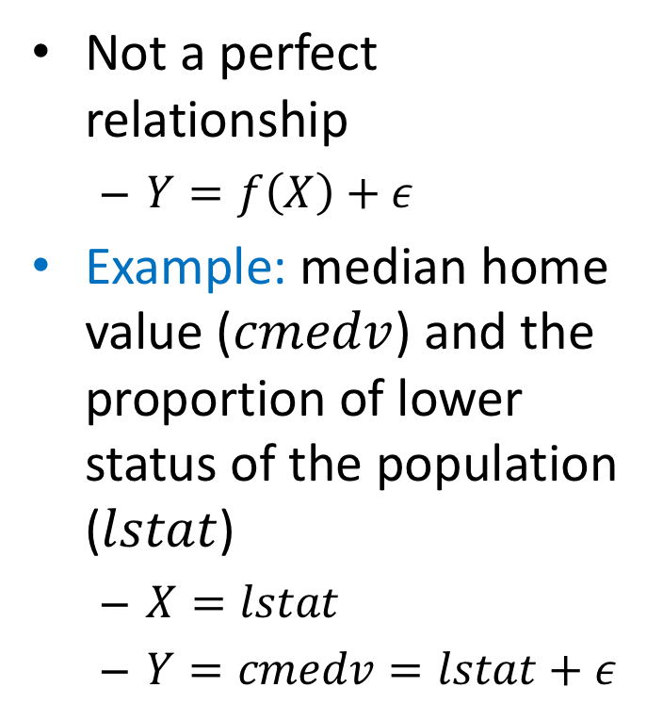
Statistical relation
Not a perfect relationship
$Y=f\left(X\right)+ε$
Example: median home value ($cmedv$) and the proportion of lower status of the population ($lstat$)
$X=lstat$
$Y=cmedv=lstat+ε$
noise

Slide 15
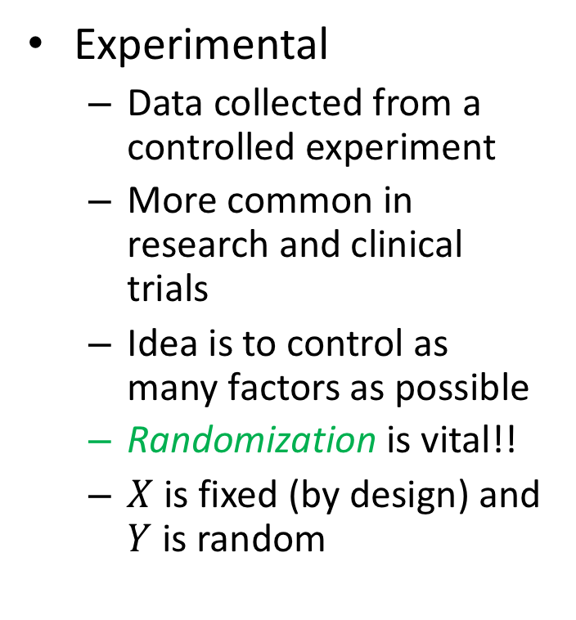
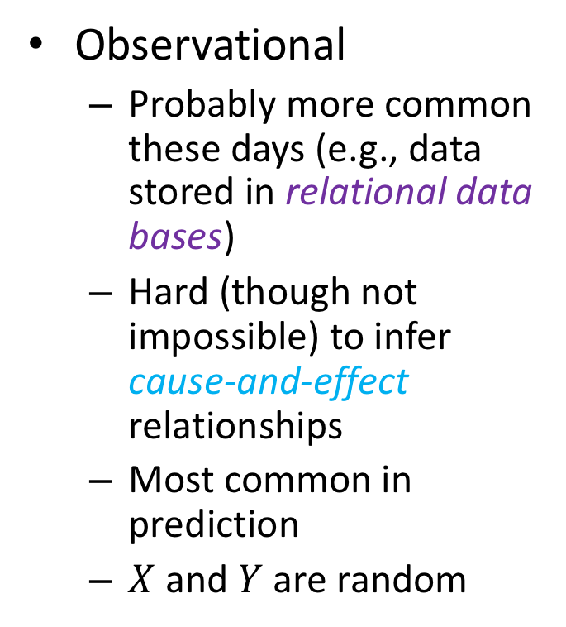
Data for regression analysis
Observational
Probably more common these days (e.g., data stored in relational data bases)
Hard (though not impossible) to infer cause-and-effect relationships
Most common in prediction
$X$ and $Y$ are random
Experimental
Data collected from a controlled experiment
More common in research and clinical trials
Idea is to control as many factors as possible
Randomization is vital!!
$X$ is fixed (by design) and $Y$ is random

Slide 16
library(ggplot2) # for advanced plotting library(investr) # for crystal and arsenic data sets p1 <- ggplot(crystal, aes(x = time, y = weight)) + geom_point() + labs(x = "Time (hours)", y = "Weight (grams)") p2 <- ggplot(arsenic, aes(x = actual, y = measured)) + geom_point() + labs(x = "True amount of arsenic", y = "Measured amount of arsenic") gridExtra::grid.arrange(p1, p2, nrow = 1)

Slide 17
R tip
In the previous slide we used the grid.arrange() function from the gridExtra package
There are two ways to use functions from other packages
Loading the package library(gridExtra). # for grid.arrange() function grid.arrange(p1, p2, ncol = 2)
Without loading package using :: gridExtra::grid.arrange(p1, p2, ncol = 2)
Package name
Function name

Slide 18


Slide 19
Historical origins
First developed by Sir Francis Galton in the later part of the 19th century
Studied heights of parents and their children
Noted that the heights of children with tall/short parents tended to “revert” or “regress” to the mean of the group
The term “regression” persists to this day!
library(HistData) # for Galton's height data library(ggplot2) # for advanced plotting ggplot(Galton, aes(x = parent, y = child)) + geom_point(alpha = 0.1) + geom_smooth(method = "lm", formula = y ~ x,
se = FALSE) + geom_abline(intercept = 0, slope = 1,
linetype = "dashed") + labs(x = "Height of mid-parent (in)",
y = "Height of child (in)")

Slide 20
Spurious Correlation

Slide 22
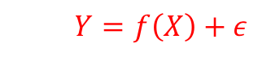
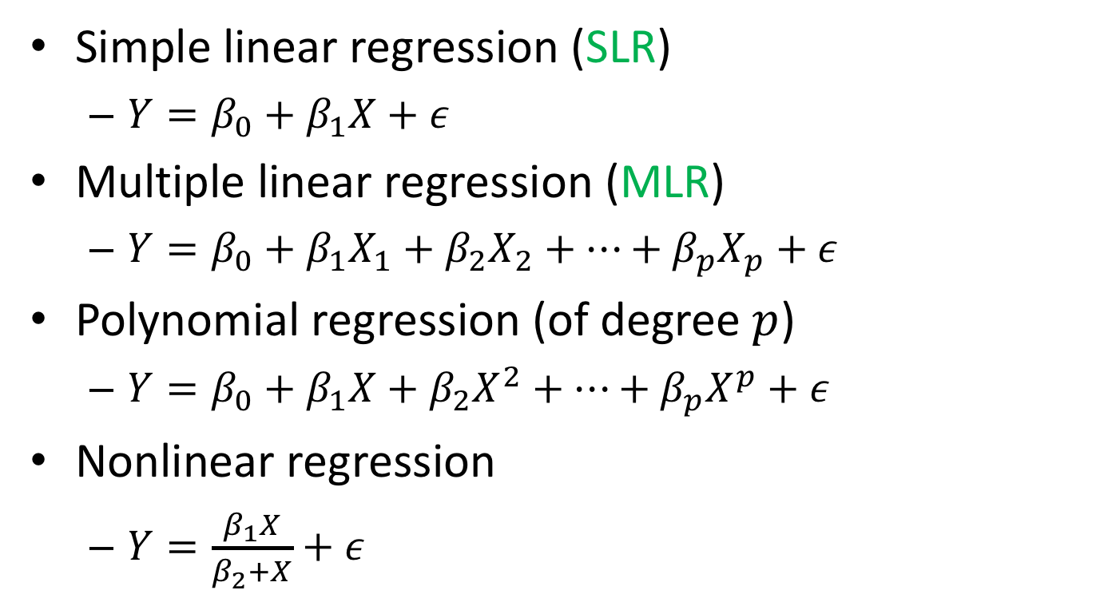
Examples of statistical relations
Simple linear regression (SLR)
$Y=β_{0}+β_{1}X+ε$
Multiple linear regression (MLR)
$Y=β_{0}+β_{1}X_{1}+β_{2}X_{2}+…+β_{p}X_{p}+ε$
Polynomial regression (of degree $p$)
$Y=β_{0}+β_{1}X+β_{2}X^{2}+…+β_{p}X^{p}+ε$
Nonlinear regression
$Y=\frac{β_{1}X}{β_{2}+X}+ε$
$$Y=f\left(X\right)+ε$$

Slide 23
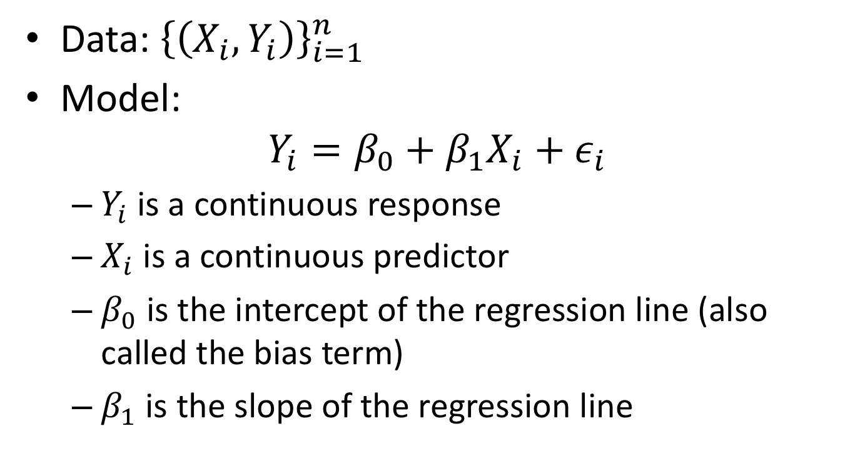
Simple linear regression (SLR)
Data: ${\left\{\left(X_{i},Y_{i}\right)\right\}}_{i=1}^{n}$
Model:
$$Y_{i}=β_{0}+β_{1}X_{i}+ε_{i}$$
$Y_{i}$ is a continuous response
$X_{i}$ is a continuous predictor
$β_{0}$ is the intercept of the regression line (also called the bias term)
$β_{1}$ is the slope of the regression line

Slide 24
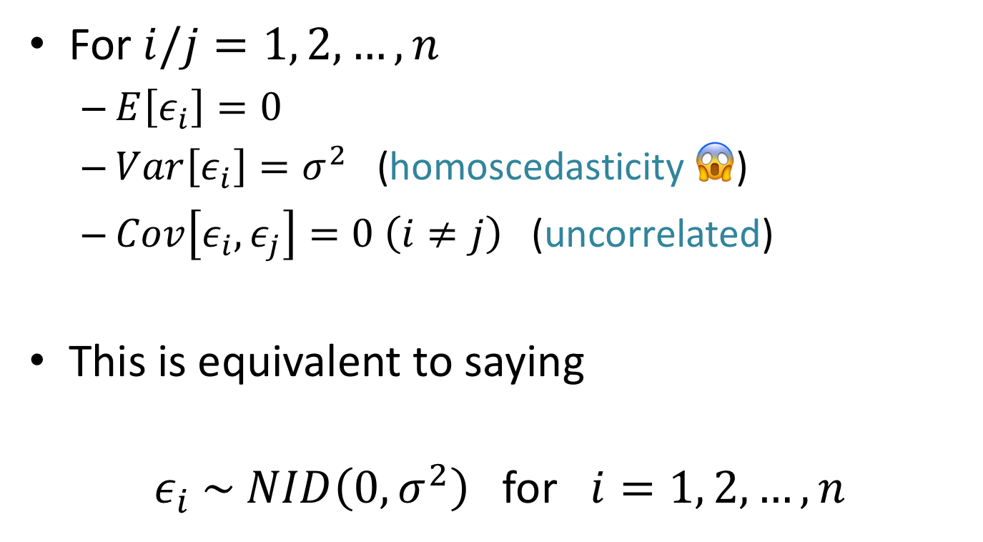

Assumptions about $ε$
For $i/j=1, 2, …,n$
$E\left[ε_{i}\right]=0$
$Var\left[ε_{i}\right]=σ^{2}$ (homoscedasticity 😱)
$Cov\left[ε_{i},ε_{j}\right]=0 \left(i≠j\right)$ (uncorrelated)
This is equivalent to saying
$ε_{i} \sim NID\left(0, σ^{2}\right)$ for $i=1, 2, …,n$

Slide 25
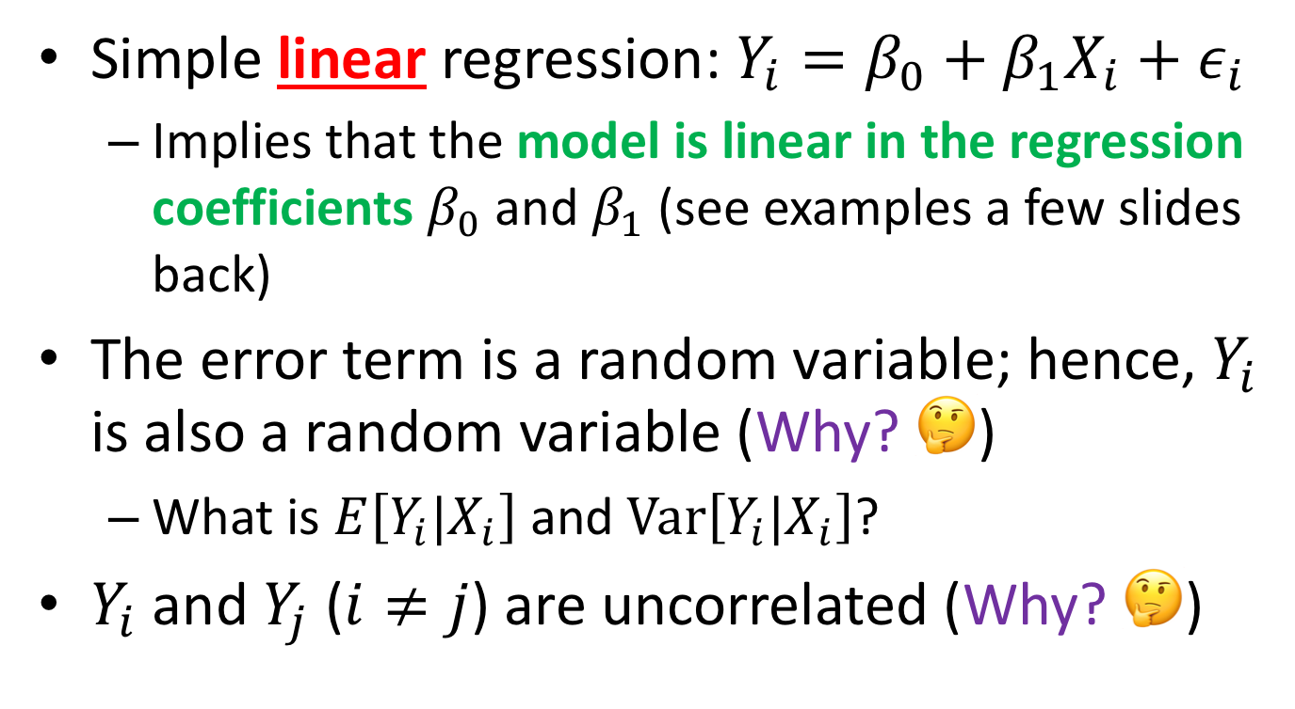
Properties of SLR
Simple linear regression: $Y_{i}=β_{0}+β_{1}X_{i}+ε_{i}$
Implies that the model is linear in the regression coefficients $β_{0}$ and $β_{1}$ (see examples a few slides back)
The error term is a random variable; hence, $Y_{i}$ is also a random variable (Why? 🤔)
What is $E\left[Y_{i}|X_{i}\right]$ and $Var\left[Y_{i}|X_{i}\right]$?
$Y_{i}$ and $Y_{j}$ ($i≠j$) are uncorrelated (Why? 🤔)

Slide 26
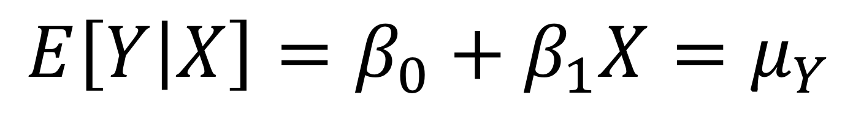
Linear predictor (LP)
$$E\left[Y | X\right]=β_{0}+β_{1}X=μ_{Y}$$
Mean response

Slide 27
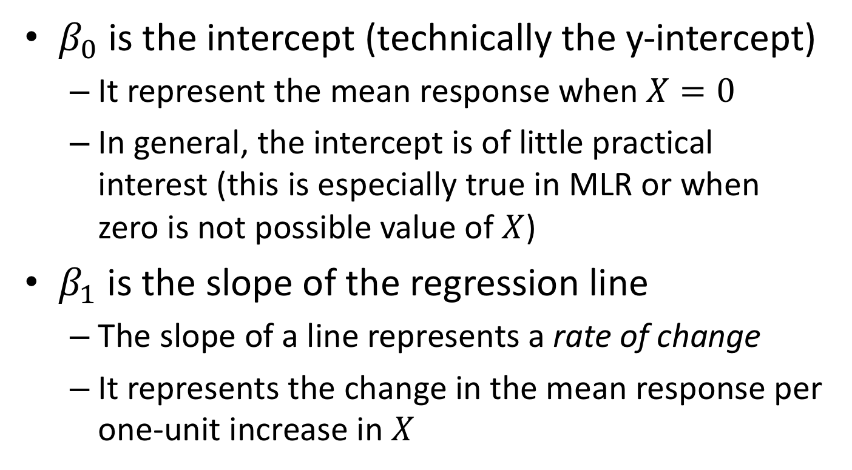

Interpreting $β_{0}$ and $β_{1}$
$β_{0}$ is the intercept (technically the y-intercept)
It represent the mean response when $X=0$
In general, the intercept is of little practical interest (this is especially true in MLR or when zero is not possible value of $X$)
$β_{1}$ is the slope of the regression line
The slope of a line represents a rate of change
It represents the change in the mean response per one-unit increase in $X$

Slide 28
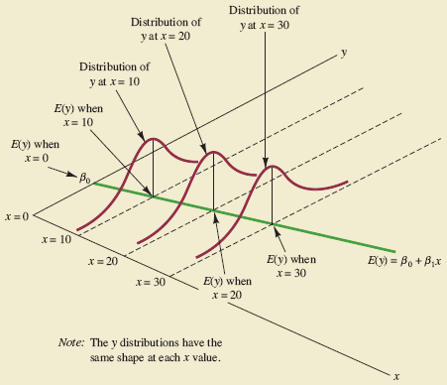

Slide 31


Slide 32
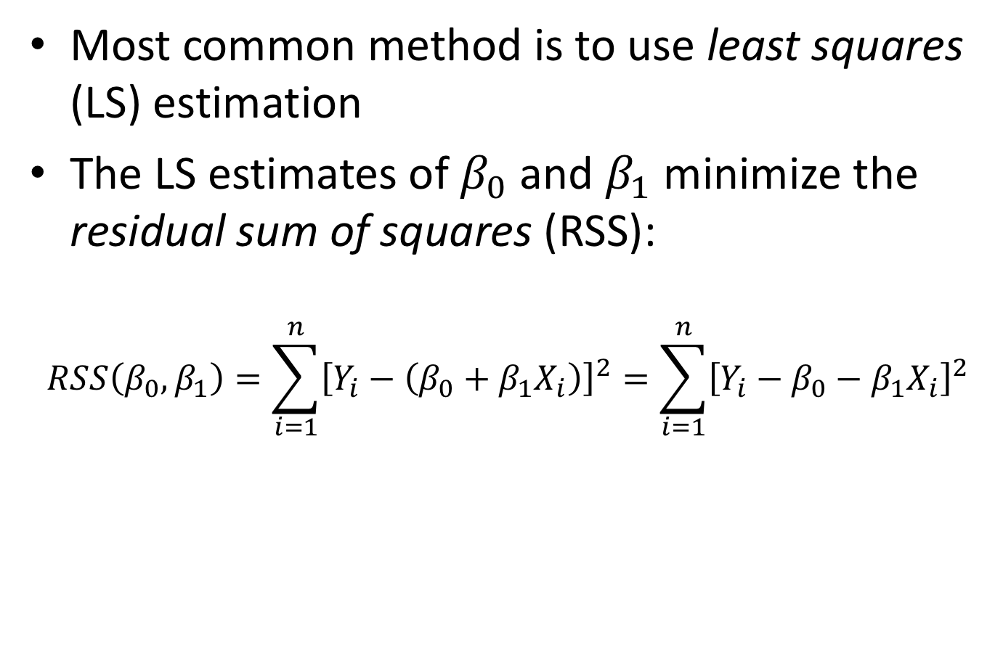

Estimating $β_{0}$ and $β_{1}$
Most common method is to use least squares (LS) estimation
The LS estimates of $β_{0}$ and $β_{1}$ minimize the residual sum of squares (RSS):
$$RSS\left(β_{0},β_{1}\right)=\sum_{i=1}^{n}{{\left[Y_{i}−\left(β_{0}+β_{1}X_{i}\right)\right]}^{2}}=\sum_{i=1}^{n}{{\left[Y_{i}−β_{0}−β_{1}X_{i}\right]}^{2}}$$

Slide 33
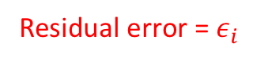
Estimating $β_{0}$ and $β_{1}$
Most common method is to use least squares (LS) estimation
The LS estimates of $β_{0}$ and $β_{1}$ minimize the residual sum of squares (RSS):
$$RSS\left(β_{0},β_{1}\right)=\sum_{i=1}^{n}{{\left[Y_{i}−\left(β_{0}+β_{1}X_{i}\right)\right]}^{2}}=\sum_{i=1}^{n}{{\left[Y_{i}−β_{0}−β_{1}X_{i}\right]}^{2}}$$
Residual error = $ε_{i}$

Slide 34
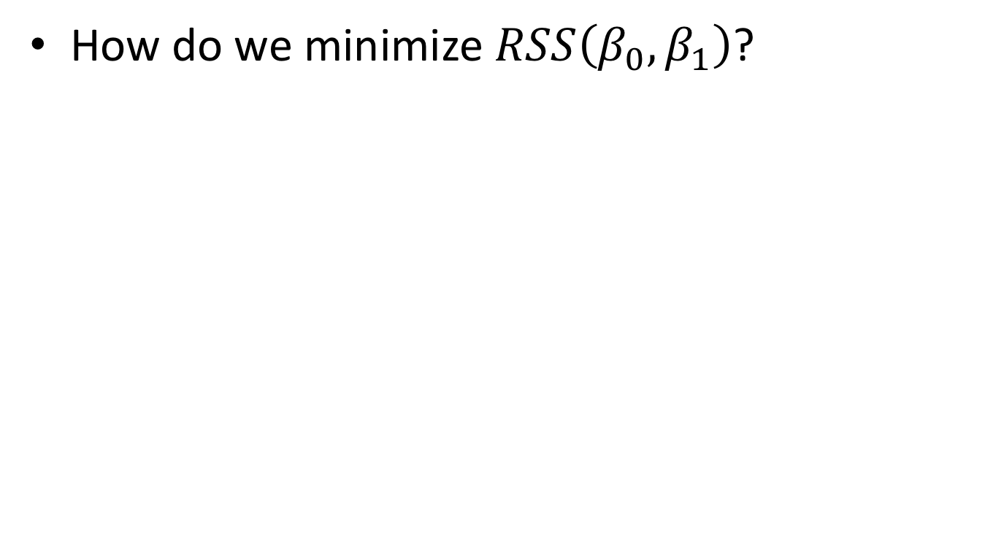
Estimating $β_{0}$ and $β_{1}$
How do we minimize $RSS\left(β_{0},β_{1}\right)$?

Slide 35
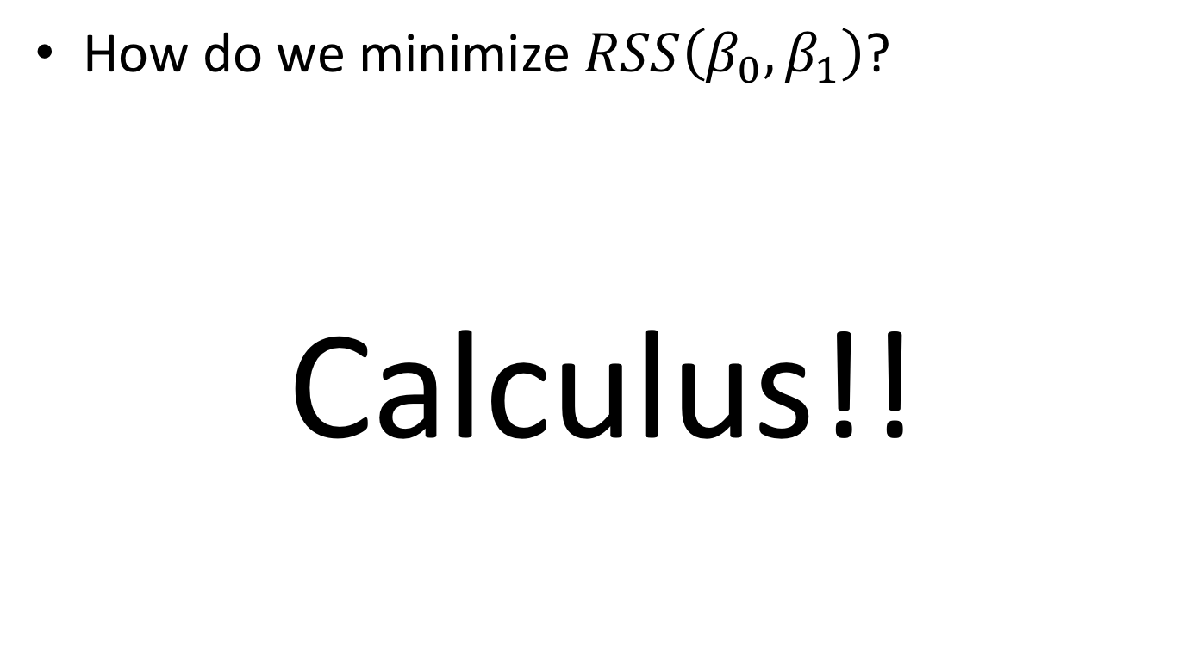
Estimating $β_{0}$ and $β_{1}$
How do we minimize $RSS\left(β_{0},β_{1}\right)$?
Calculus!!

Slide 36
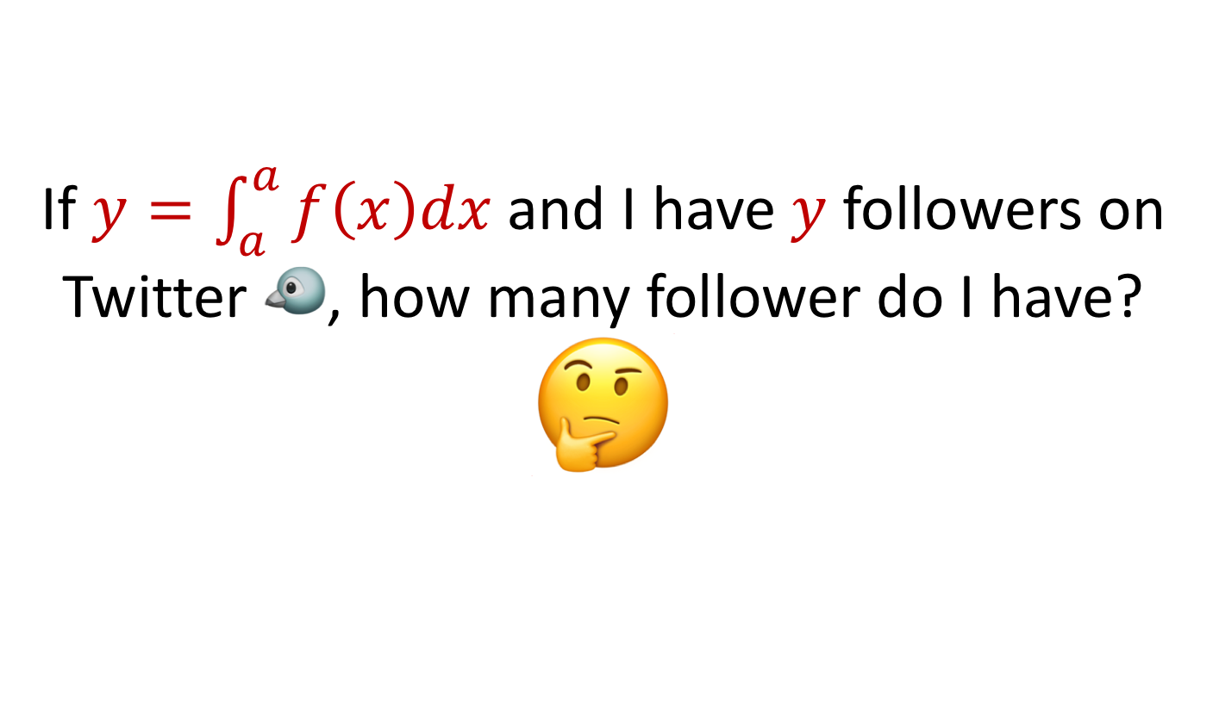
Test to see if you remember calculus
If $y=\int_{a}^{a}{f\left(x\right)dx}$and I have $y$ followers on Twitter 🐦, how many follower do I have? 🤔

Slide 37
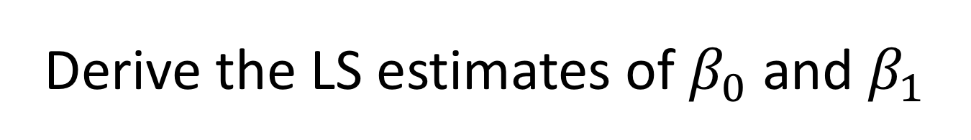
Derive the LS estimates of $β_{0}$ and $β_{1}$

Slide 38
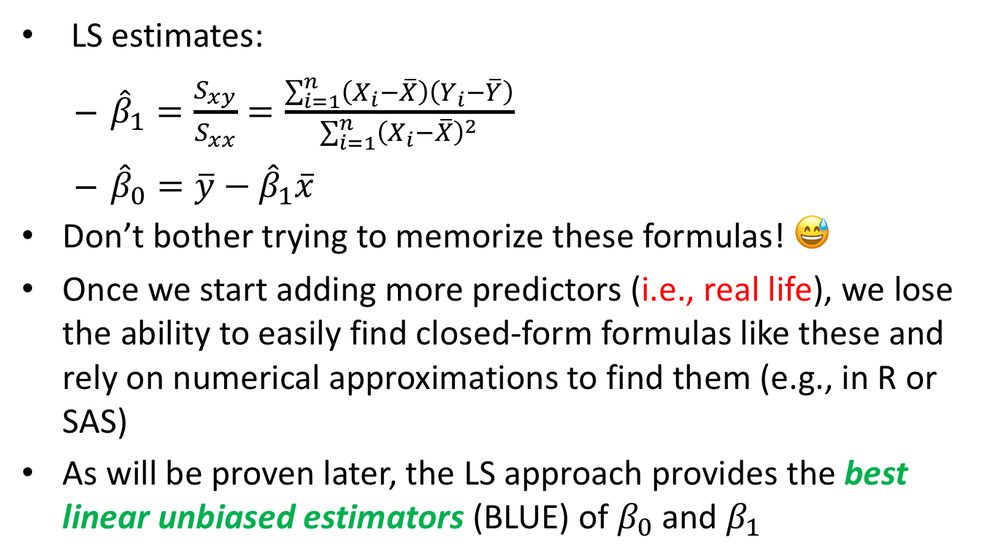
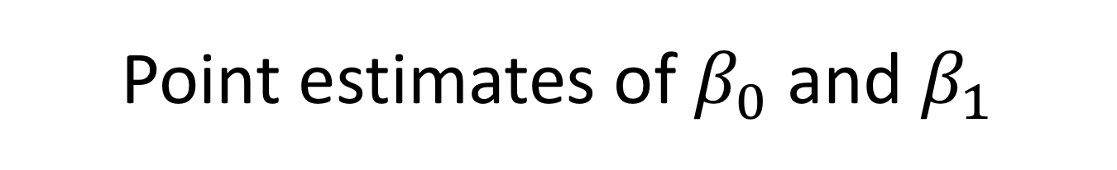
Point estimates of $β_{0}$ and $β_{1}$
LS estimates:
${\hat{β}}_{1}=\frac{S_{xy}}{S_{xx}}=\frac{\sum_{i=1}^{n}{\left(X_{i}−\overline{X}\right)\left(Y_{i}−\overline{Y}\right)}}{\sum_{i=1}^{n}{{\left(X_{i}−\overline{X}\right)}^{2}}}$
${\hat{β}}_{0}=\overline{y}−{\hat{β}}_{1}\overline{x}$
Don’t bother trying to memorize these formulas! 😅
Once we start adding more predictors (i.e., real life), we lose the ability to easily find closed-form formulas like these and rely on numerical approximations to find them (e.g., in R or SAS)
As will be proven later, the LS approach provides the best linear unbiased estimators (BLUE) of $β_{0}$ and $β_{1}$

Slide 39
Visual Least Squares

Slide 40
Fitting the SLR model in R
The lm() function can be used to fit the SLR model (or any LM for that matter!)
The statement lm(y ~ x, data = df) fits a SLR model by regressing y on x, where y and x are columns in df
To suppress the intercept term, use
y ~ x - 1
Rocket propellant example

Slide 41
Pop quiz
Interpret the coefficients from the fitted rocket propellant SLR model:
# Extract the LS estimated of the intercept and slope
coef(rocket_slr)
## (Intercept) x
## 2627.82236 -37.15359

Slide 42
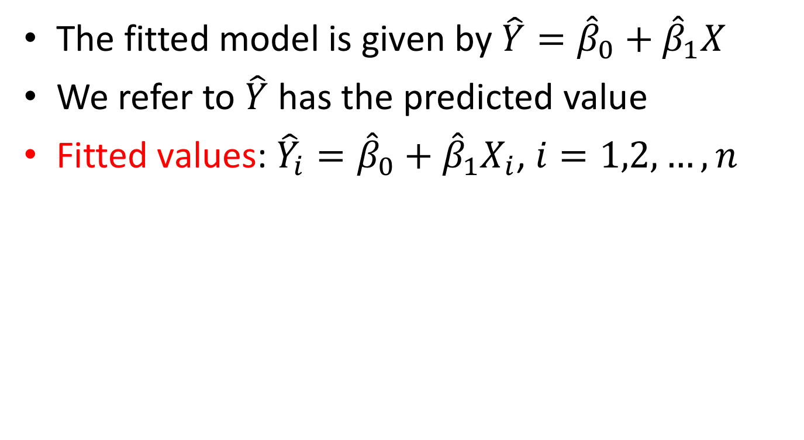
The fitted SLR model
The fitted model is given by $\hat{Y}={\hat{β}}_{0}+{\hat{β}}_{1}X$
We refer to $\hat{Y}$ has the predicted value
Fitted values: ${\hat{Y}}_{i}={\hat{β}}_{0}+{\hat{β}}_{1}X_{i}$, $i=1,2,…,n$
y | x | fit | res
2158.7 | 15.5 | 2051.9417 | 106.758301
1678.15 | 23.75 | 1745.42457 | -67.274574
2316 | 8 | 2330.59363 | -14.593631
2061.3 | 17 | 1996.21131 | 65.0886871
2207.5 | 5.5 | 2423.47761 | -215.97761

Slide 43

Residuals: $e_{i}=Y_{i}−{\hat{Y}}_{i}$

Slide 44
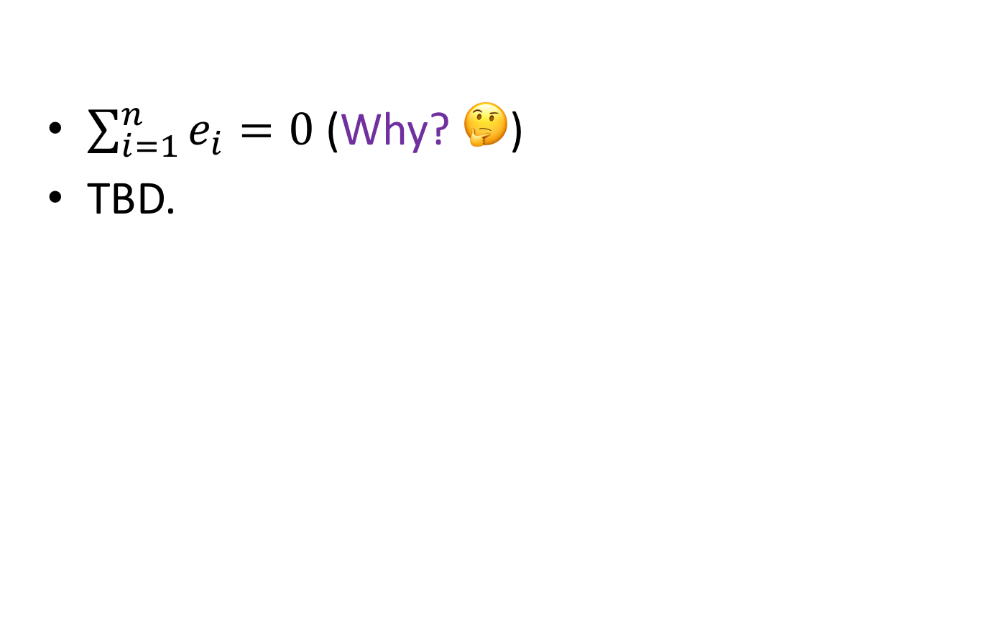
Properties of the residuals
$\sum_{i=1}^{n}{e_{i}}=0$ (Why? 🤔)
TBD.

